Slide 1
Social Acceptance of Nomadic Virtual Reality
Forschungsseminar: MMI

Slide 2
Project Summary
The study´s topic is to find out more about the „Acceptance of Nomadic Virtual Reality“ in public places based on previous researches by performing a field study.

Slide 3
Related Work
Research showed VR glasses might be acceptable in certain social situations
→based on digital questionnaires and images
WEAR-Scale document
No WEAR-Scale as questionnaire (too long)
→use SCM for the whole study, not just baseline

Slide 4
Method
Study Design
Independent Variable:
Gender of the actor
VR goggles / no VR goggles
Gestures / no gestures
Location, Time
Dependent Variable:
- Acceptance Rating

Slide 5
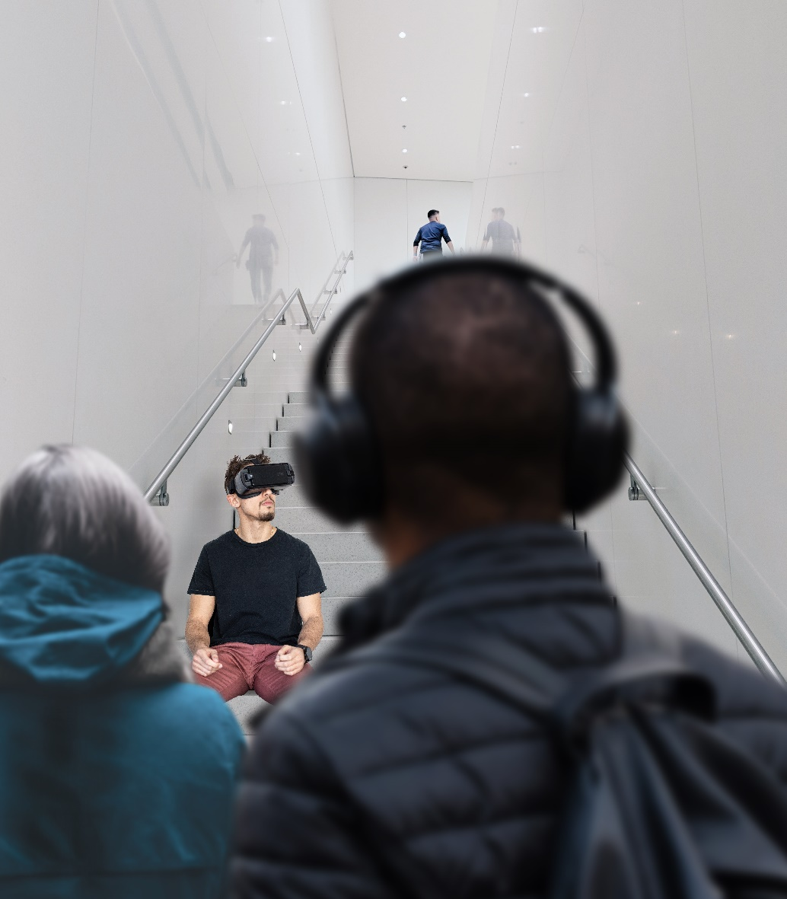
Method
Apparatus / Prototype

Slide 6
Method
Stimuli / Conditions
Gender of the actor
VR goggles / no VR goggles (baseline)
Gestures / no gestures (baseline)

Slide 7
Method
Procedure / Participant Recruiting
Actor / actress enters the chosen location and takes a seat
Let the situation act on nearby passerby
Interview nearby passerby
Each passerby fills out a demographic questionaire and a consent form
Each passerby fills out an „Acceptance Questionaire“
Hand out a reward
Each nearby passerby is a potential test person of our study

